Slide 1
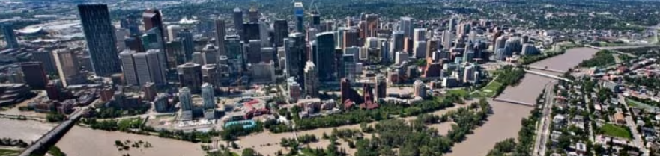
Calgary Flood Prediction Model by Richard Barad & Jarred Randall

Slide 2
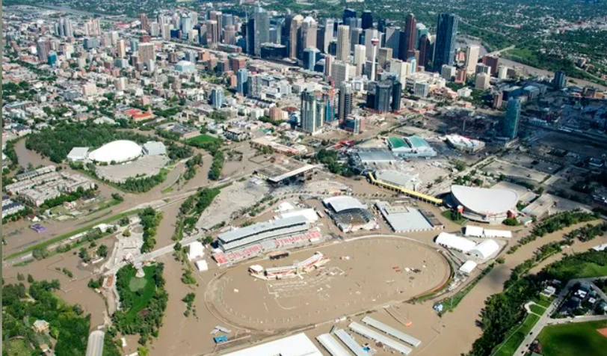
Planning Motivation
In June 2013 Calgary experienced extreme flooding even resulting in the displacement of 100,000 people and 1.7 billion dollars in damages.
One of the worst flooding events in Canada’s history.
Photo by Jonathan Hayward of the Canadian Press

Slide 3
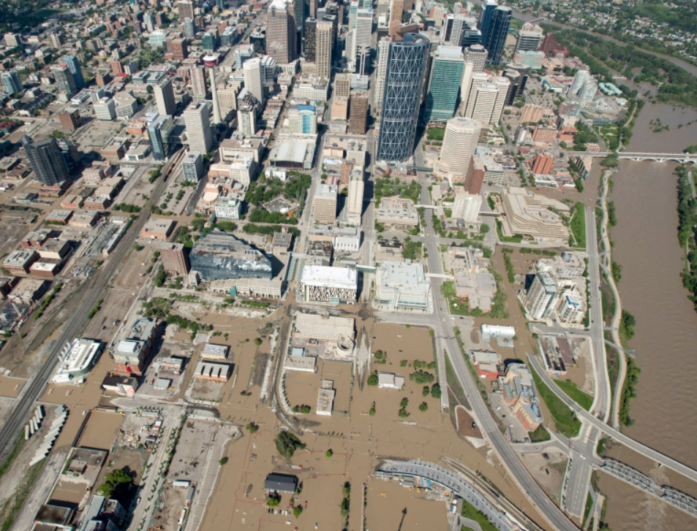
Why Predictive Modeling
Early Action and Planning for Flooding events
Provides decision-makers and the public with information on potential evacuation areas.
Identifies areas needing buyouts or building code revisions for floodproofing.
Captures potential flooding beyond river areas, including low-lying areas and valleys.
Based on historical events, enhancing predictive capability for non-riverine floods.
Can be adapted for other cities
Photo by Jonathan Hayward of the Canadian Press

Slide 4
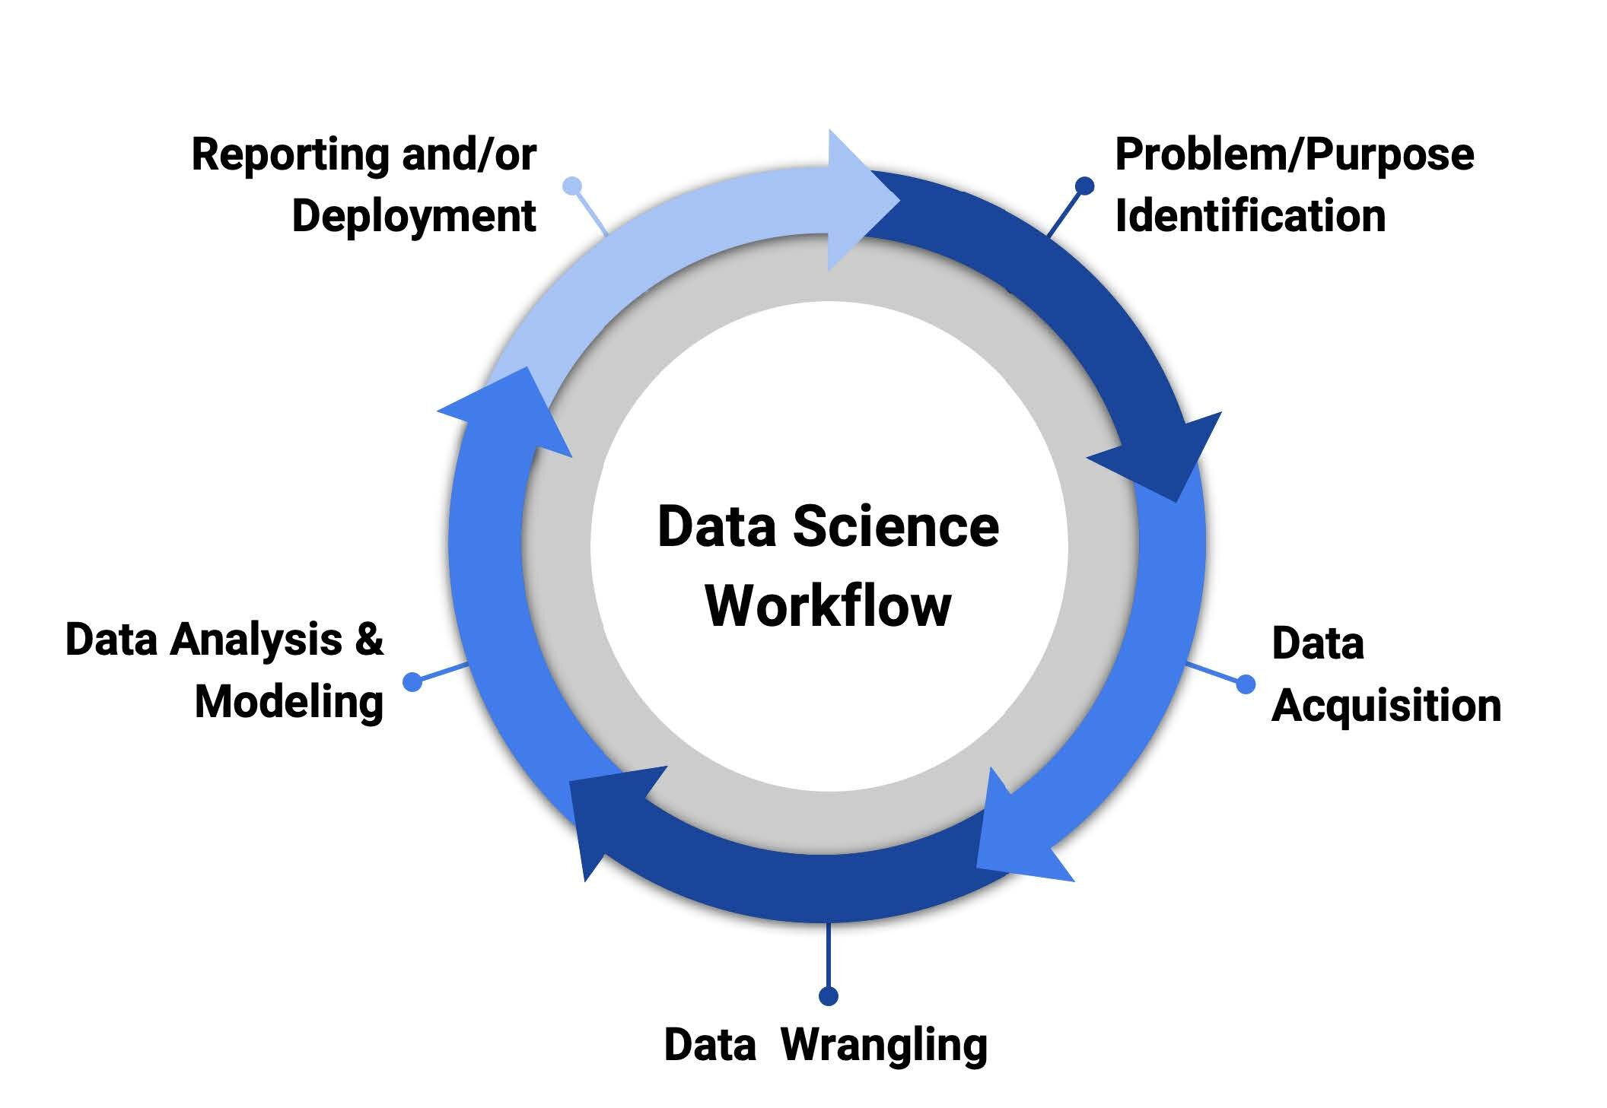
Flood Risk Prediction Process
Problem Identification: Recognize flooding as the key issue to address.
Data Acquisition: Gather all relevant data pertaining to historical flood events.
Data Preparation: Clean the data and format it into a structured dataset.
Data Analysis: Examine the data to understand patterns and trends.
Feature Engineering: Create new data features to improve model accuracy.
Modeling: Run the logistic regression model to predict flood-prone areas.
Deployment: Translate model predictions into actionable insights for stakeholders.

Slide 5
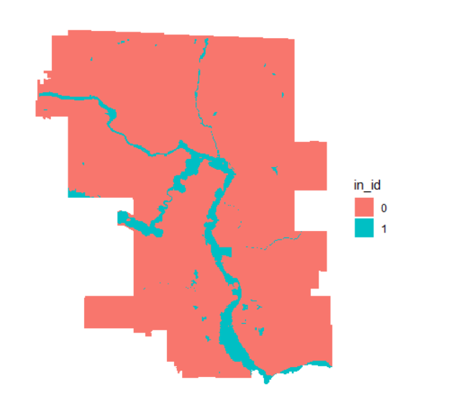
Flood Risk Assessment with Logistic Regression
Analysis creates 100m x 100m grid cells for Calgary
Utilizes a logistic regression model to predict flood-prone areas.
Trained and tested using 2013 historical Calgary flood event data.
Calgary Flood Inundation Areas

Slide 6
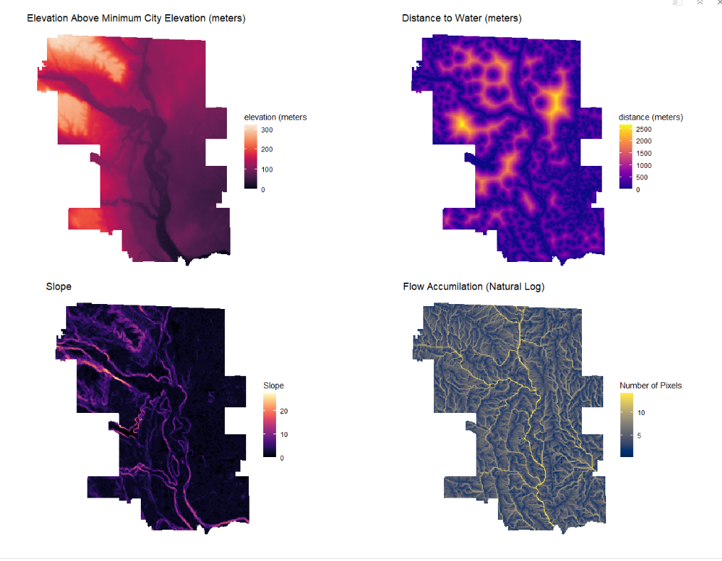
Predictor Variables
Elevation above city minimum elevation
Distance to water
Slope
Flow Accumulation (Natural log)
Dominant Landcover Type

Slide 7
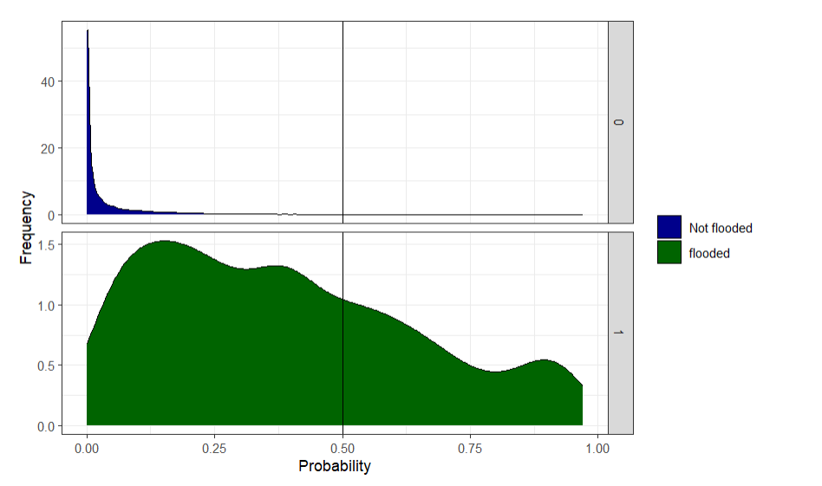
Model Results : Threshold
0.12 optimal model threshold

Slide 8
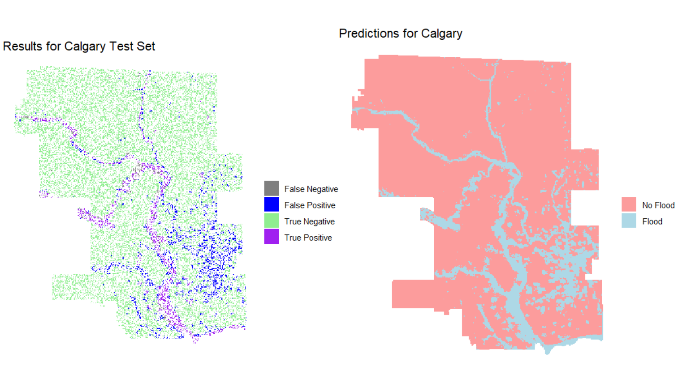
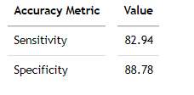
Model Results
Model Overall Accuracy: 88%
Predicts 83% of flooded grid cells accurately (sensitivity).
Predicts 88% of non-flooded grid squares accurately (specificity).

Slide 9
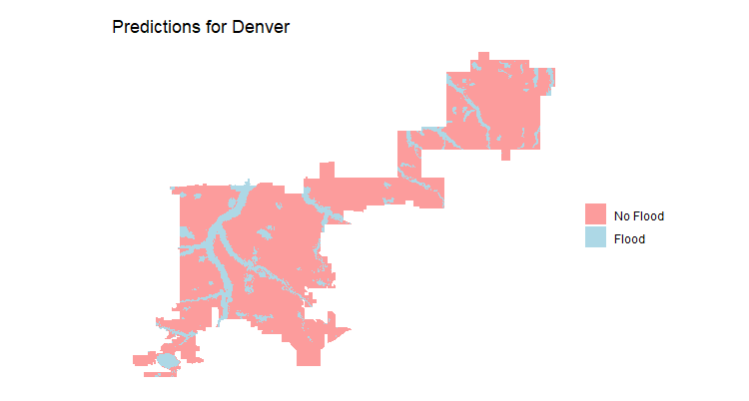
Denver flood Predictions
Because the model is generalizable to different data we can apply it to different cities
Areas that are predicted to be flooded in Denver tend to be located near water bodies

Slide 10
Thank You

